Slide 1
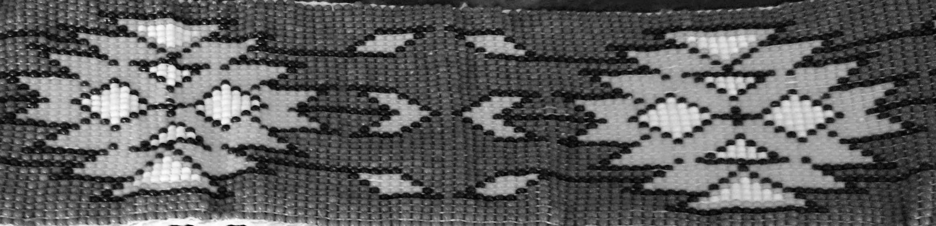
Adaptive Leadership & Deep change
a presentation by Dr. Jacqueline Ottmann

Slide 2

Notes:
https://biomimicry.org/biomimicry-design-spiral/
in one ‘lap’ around the Biomimicry Design Spiral you:
Identify one or more functions that you want your design to perform,
Translate those functions into biological terms,
Discover strategies that nature uses to perform those functions,
Abstract those strategies back into technical terms,
Emulate those strategies in your design solution,
Evaluate your design against your design brief and Life’s Principles, and then decide how you want to use your next lap.
The Power of Habit by Charles Duhigg, Atomic Habit, James Clear – Nature Butterfly Effect

Slide 3
Timeless truths
Systemic change is deep seated, does not shy away from truth that can transform and strengthen, and is ready to exercise its power when invited. This force demands courage and those that see vulnerability and humility as companions, because the space that appears is dynamic and unstable, filled with uncertainty, but hopeful to the healing and wellness that can occur by moving through it. Experiencing this chaos and seeming disorder leads to a wellspring of possibility, an awakening to the essence of interconnected relationality, and to the realization of the beauty that accompanies creativity.

Slide 4
Where / What is the source?
Who am I? | Who are we?
Where do I come from? | Where do we come from?
Where am I going? | Where are we going?
What are my responsibilities? | What are our responsibilities?
Notes:
wah-nān-geen?
ānīn ēšinihkāsowan?
Vision quest

Slide 5
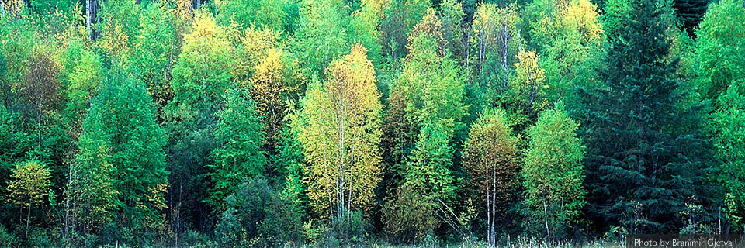
Notes:
“We live in a beautiful world … The spirit of the Creator, his energy, is part of all things in this world. There is nothing else. Yet, it is all things. Everything that exists is a part of nature and has a reason and a purpose”
Cree Elder, Ahtahkakoop, 2000, p. 7.

Slide 6
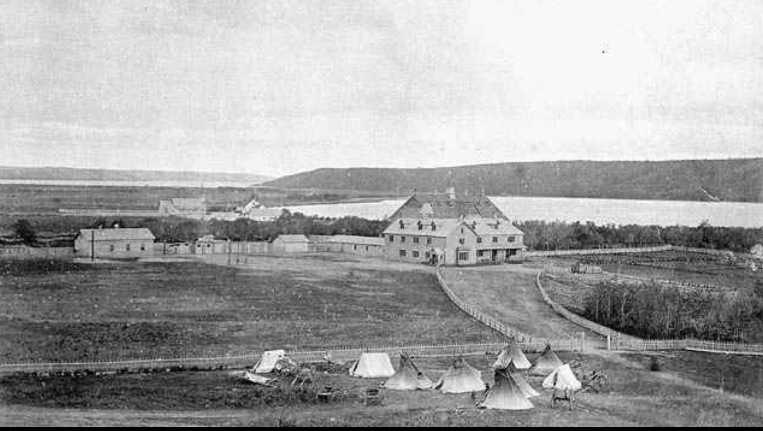
https://collections.irshdc.ubc.ca/index.php/Detail/occurrences/195
Notes:
Distant view of Fort Qu'Appelle Indian Industrial School with tents, [Red River] carts and teepees outside the fence, Lebret, Saskatchewan, [May 1885?]. Image courtesy of Library and Archives Canada.

Slide 7
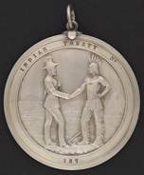
trust, hope for peace, friendship and respect
Notes:
Treaty negotiations; convential
Strength based perspectives, Appreciative Inquiry
Discovery: what gives life (define the best of what is) – appreciating
Dream: What could be. Innovating, envisioning what is possible
Design: What should be, building the ideal, co-constructing
Destiny: empower, learn, evaluate, adjust. What will be, sustaining excellence

Slide 8
Where am I going?
To learn the complex and ever-changing steps of the ‘dance’ between education, research and leadership for the purpose of creating ethical spaces, respectful relationships and dynamic places, that will lead to meaningful and sustainable change, primarily for Indigenous peoples and for the benefit of all.

Slide 9
What are my responsibilities?
Sharing my story, listening to others’ stories
“To all my relations”
“To Seven Generations before and after me”

Slide 10
How do I define & know?
EDUCATION: “Coming to Know”
RESEARCH: Protocol, listening, observing,
storytelling
LEADERSHIP: Service ‘with’ people done
“in a good way”
Notes:
Schooling, research as discovery, leadership as responsibility. No choice but to use voice

Slide 11
Inescapable Inter-connectedness
“This we know: All things are connected like the blood that unites us. We did not weave the web of life, we are merely a strand in it. Whatever we do to the web, we do to ourselves.”
Chief Seattle

Slide 12
The Learning spirit
Indigenous worldviews on education and schooling
  boundary versus boundaryless
  concept versus spirit
Indigenous pedagogies & methodologies
  experiential, community responsibility (all my relations), strength-based, oral traditions (storytelling), rites of passage, life-long learning (humility)

Slide 13
Organizational learning
Three types of organizational learning:
  Single loop
  Double loop
  Deutero-learning

Slide 14
Organizational Learning & Change
Single loop learning focusses on change without questioning underlying assumptions and core beliefs.
- first order change
Double loop and Deutero-learning are concerned with the why and how to change the in the organization
- second order change
Notes:
FIRST AND SECOND ORDER CHANGE: technical existing structure) versus transformational (acknowledging and providing services for EDIA with changing the system, Indigenous peoples without recognizing and compensating differences in pedagogies, methodologies, histories; providing resources eg. Connectivity, more books for the library, counselling services within building)
Change: Meaningful, measurable, manageable.

Slide 15
Organizational learning
Argyris (1976) proposes double loop learning theory which pertains to learning to change underlying values and assumptions. The focus of the theory is on solving problems that are complex and ill-structured and which change as problem-solving advances.
Notes:
Shapeshifting – supernatural

Slide 16
Learn then leap
Organizational Readiness
Gauging change valance
Leadership: Trust & courage
Notes:
Stockhom bungy located in the Swiss Alps is one of the most breathtaking and unusual bungy sites in the world. You are lifted 134m up in a mountain gondola, the doors open and you take the plunge; leaping and freefalling towards the pristine mountain lake Stocksee. 450 ft- 134 m
This girl has taught me how to actively listen…story
To feel comfort in the whole world. I’ve used these visuals to teach about leadership, leading on the edge, embracing open systems by taking risks. Fearlessness, or fearful but trusting in the possibilities – Trust.
A theory of org readiness for change (Bryan Weiner): Organizational readiness for change is a multi-level, multi-faceted construct. As an organization-level construct, readiness for change refers to organizational members’:
shared resolve to implement a change (change commitment) and
shared belief in their collective capability to do so (change efficacy).
Organisational valence refers to how much an individual values a particular change or proposed outcome.
Do organizational members value the specific impending change? Do they think that it is needed, important, beneficial, or worthwhile?
The more organizational members value the change, the more they will want to implement the change, or, put differently, the more resolve they will feel to engage in the courses of action involved in change implementation.
Organisational valence has been shown to impact a range of outcomes including:
How committed on individual is to the organisation
Their responses to organisational change
Individual motivation and the motivation of management
Individual well-being
How much people respect each other

Slide 17
Global forces
Global Pandemic
Race (George Floyd)
Historical relations with Indigenous Peoples
Moore’s Law (technology)
The Market (globalization)
Mother Nature (climatization & loss of biodiversity)
      Thomas Friedman (2016)
Notes:
We all sense it, something big is happening Black Elephant. Whether we like it or not, we are on this wave of accelerated change. “This is a full on societal reinvention challenge”
Dynamic stability, Radical Inclusivity
Moore’s Law (Gordon and I integrated circuits 60 elements to sixty thousand in 10 years, doubling is now happening every two years: Acceleration exponentially doubles in shorter and shorter time frames. Change in technology was amazing when it doubled in 10 years, now it’s happening every two years
Platforms of trust, global flows, sharing economy; physical versus societal technologies – how are we going to keep up?
Resilient, adaptive, connected communities, power of many “this is a full on societal reinvention challenge”
Byron Auguste, former economic advisor to President Obama said, “In today’s knowledge-human economy it will be human capital – talen, skills, tacit know-how, empathy, and creativity. These are massive, undervalued human assets to unlock, and our educational institutions and labour markets need to adapt to that. RBC report. Cheaper faster, reach the masses. Goal, dynamic economy and inclusive society. We need to rethink social contracts – those between workers and employers, students and educational institutions, and citizens and governments. Full potential
Educational systems must be retooled to maximize strong fundamentals in reading, writing, coding, and math; creativity, critical thinking, communication, and collaboration; grit, self-motivation, and lifelond learning habits, and entrepreneurship and improvisation – at every level.

Slide 18
Educational challenge
“So, at a minimum, our educational systems mut be retooled to maximize these needed skills and attributes: strong fundamentals in writing, reading, coding, and math; creativity, critical thinking, communication, and collaboration; grit, self-motivation, and lifelong learning habits; and entrepreneurship and improvisation – at every level” (Friedman, 2016, p. 212)
Notes:
OECP re-imaginging education
Rapid and continuous learning (farming)
Block out noise- concentration – big family
RBC report

Slide 19
Creativity & innovation
Cycling, recycling into new contexts, into dynamic spaces and places
Chasing the fireflies
Intuition & Open systems
Notes:
https://biomimicry.org/biomimicry-design-spiral/
in one ‘lap’ around the Biomimicry Design Spiral you:
Identify one or more functions that you want your design to perform,
Intuition is a spiritual act.
Translate those functions into biological terms,
Discover strategies that nature uses to perform those functions,
Abstract those strategies back into technical terms,
Emulate those strategies in your design solution,
Evaluate your design against your design brief and Life’s Principles, and then decide how you want to use your next lap.
The Power of Habit by Charles Duhigg, Atomic Habit, James Clear – Nature Butterfly Effect

Slide 20
Leadership & Organizational Theory & Practice
Adaptive Leadership || Responsive Leadership || Change Theory || Quantum Physics
Complexity Theory || Seven Generations
Art-Science connection of leadership & life
  (“Power of Habit” ; “Braiding Sweetgrass: Indigenous Wisdom, “Scientific Knowledge and the Teachings of Plants” Robin Wall Kimmerer, Bittersweet, Susan Cain, Thank you for being Late, Thomas Friedman)
Notes:
LEARNING
I’ve been intrigued by ancient treaties, those even before Europeans arrived like the Great Law of Peace agreed upon by the Iroquois Confederacy, the Six Nations (Mohawk, Onondaga, Oneida, Cayuga, Seneca, and Tuscarora peoples). The US constitution was modelled after this covenant – after this highly evolved participatory democratic process.
I’ve also drawn a lot of my work on the lessons learned from the Haudenosaunee two-row wampum treaty (Kaswentha-1613) – the parallel development that it teaches. While developing the U of C Indigenous Strategy, Blackfoot Elder Reg Crowshoe encouraged us not to mix culture, as this causes confusion, but to look for parallels. If you think about this, this is how our very existence is constructed - DNA

Slide 21
The responsibility of leadership
As leaders to accomplish readiness for change, how do we create a sense of urgency?
Inspire to motivate (rankings, incentives)
How do raise change valance?
Lead in a time of constant flux during uncertainty
Notes:
What is your philosophy and definition of leadership? Who am I…
Leader said, Come to me with solutions.
Adaptive leadership vs technical leadership – complexity theory (7 gen)
Waniska

Slide 22
Spirit questions
There needs to be some time to reflect … we need to get back to understanding the things … What are we teaching kids about Creator law, about the principle of relationships and how we are related? How are we teaching people how to love one another, about working with one another, about sin, about jealousy? … There is so much that could be taught around that. (Ottmann, 2005)

Slide 23
The Key determiner - Relationships
The quantum view of reality strikes against most of our notions of reality. Even to scientists, it is admittedly bizarre. But it is a world where relationship is the key determiner of what is observed and of how particles manifest themselves. ... Many scientists now work with the concept fields - invisible forces that structure space or behaviour. (pp. 8-13)
Notes:
Wholistic approaches

Slide 24
Transformative values
The ILP Working Group identified the following values within an institution that should be present to facilitate transformative institutional leadership:
openness, through a demonstrated belief that Indigenous education is everybody’s business, not just Indigenous student services,
enduring leadership, through a long-term commitment to an Indigenous employment strategy,
transformation, by extending the learning of the individual into their respective communities,
Notes:
Institutional Leadership Paradigm Project: Transforming Practices, Structures and Conditions in Indigenous Higher Education

Slide 25
Transformative values
cultural integrity, through approaches to learning and teaching imbued with Indigenous traditions,
empowerment, including and involving the students’ families, as well as the students themselves,
partnerships, bringing communities into the university,
inclusion, providing higher education in communities. (2007)

Slide 26
Indigenous wAYS OF BEING, KNOWING, & DOING
University of Calgary Indigenous Strategy https://www.ucalgary.ca/live-uc-ucalgary-site/sites/default/files/teams/136/Indigenous Strategy_Publication_digital_Sep2019.pdf
University of Saskatchewan Indigenous Strategy https://indigenous.usask.ca/documents/lets-fly-up-together.pdf
First Nations University of Canada https://www.fnuniv.ca/wp-content/uploads/FNUniv.StrategicPlan.FinalVersionWeb2019.pdf
Notes:
Relationship: 1613

Slide 27
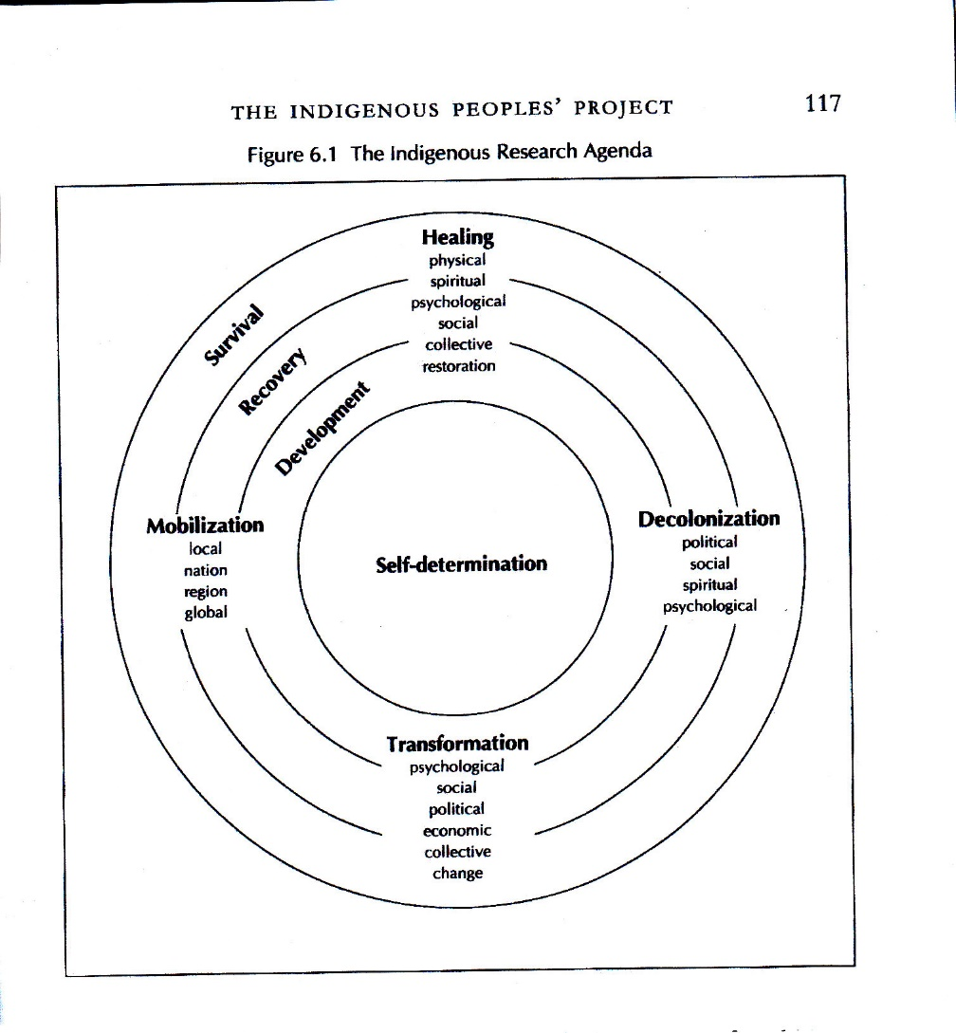
Wholistic approaches
Linda Tuhiwai Smith, 2001, p. 117

Slide 28
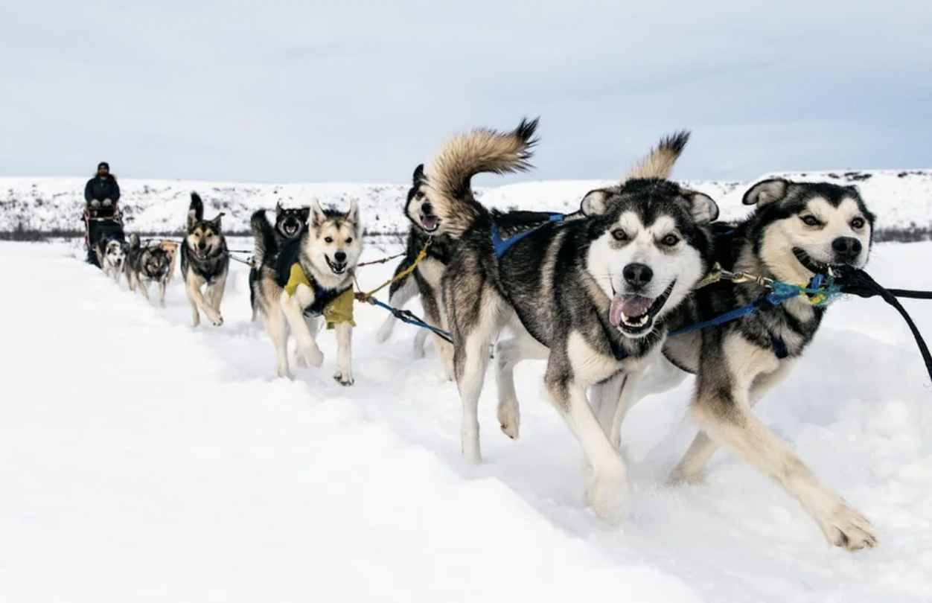
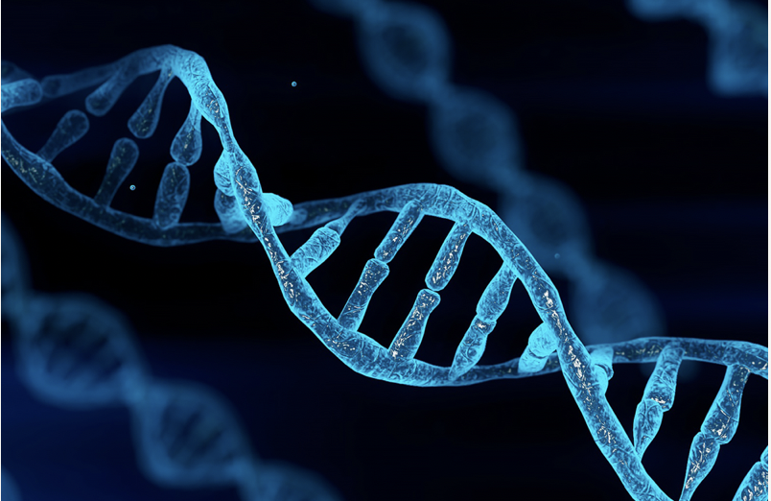
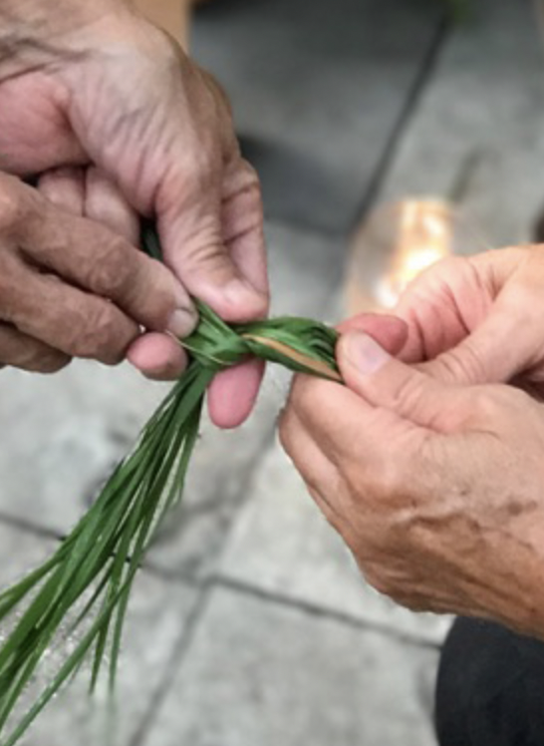
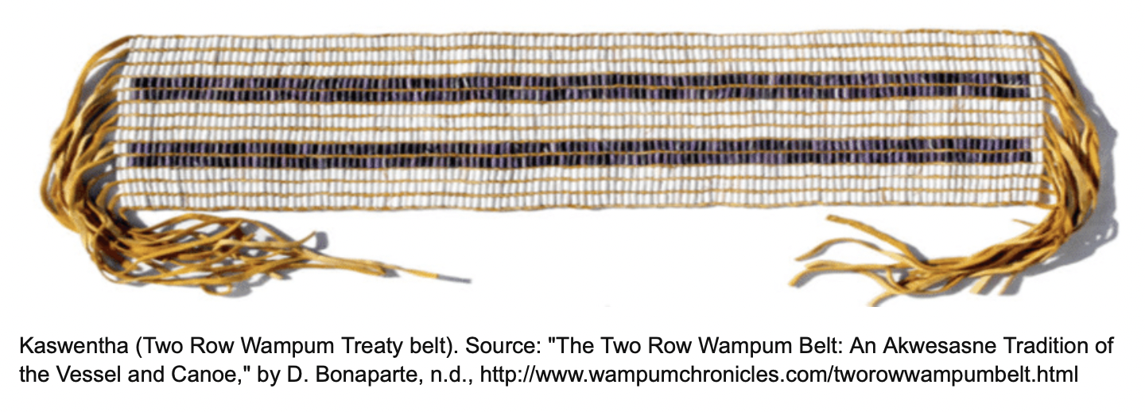
https://www.reddit.com/r/dogswithjobs/comments/ngd1uf/alaskan_dogsled_team/
Notes:
Bittersweet

Slide 29
Many People, One Destiny
We are caught in an inescapable network of mutuality, tied in a single garment of destiny. Whatever affects one directly, affects all indirectly. Never again can we afford to live with the narrow, provincial “outsider agitator” idea. Anyone who lives inside [his/her country] can never be considered an outsider anywhere within its bounds.
Martin Luther King Jr.

Slide 30
Thinking outside the box
…Living within the Circle (Cajete, personal communication)
Complex thinking, complex organization
Notes:
Princess Alexandra
International Research Project, University of Calgary, University of Saskatchewan, FNUniv -MCF

Slide 31
SUMMARY
We move mountains by first moving ourselves, and the way we educate makes all the difference in the world. The choice is ours. We make the difference. It is we who decide to live, or not to live, our visions. We are the creators of the world and the realities that we live in. We are the ones who must choose the path of our own learning [and teaching]. (Cajete, 1994)
Notes:
“Take this story, for instance. It’s yours. Do with it what you will. Tell it to your friends. Turn it into a television movie. Forget it. But don’t say in the years to come that you would have lived your life differently if only you had heard this story.” (King, 2003, p. 29)

Slide 32
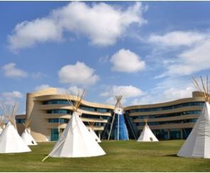
Miigwetch
Mizowaykomiguk-paypomwayotung
jottmann@firstnationsuniversity.ca
www.fnuniv.ca

